Slide 1
Causal Inference Crash Course Part 5: Heterogeneous Treatment Effect Models and Inference
Julian Hsu (@hsujulia)

Slide 2
Causal Inference Series
Foundations
Defining Some ATE/ATET Causal Models
ATE/ATET Inference, Asymptotic Theory, and Bootstrapping
Best Practices: Outliers, Class Imbalance, Feature Selection, and Bad Control [skipped for now]
Heterogeneous Treatment Effect Models and Inference
Difference-in-Difference Models for Panel Data
Regression Discontinuity Models
Arguable Validation

Slide 3
Overview
This presentation covers the general problem of estimating heterogeneous treatment effects (HTE) and how it differs from ATE/ATET estimation.
Covers a few models:
Double Machine Learning following Semenova et al. (2021)
Heterogeneous Residuals
Causal Forests / Local Linear Forests
Doubly Robust models following Kennedy (2020)
Wrap up with a simulation demonstration

Slide 4
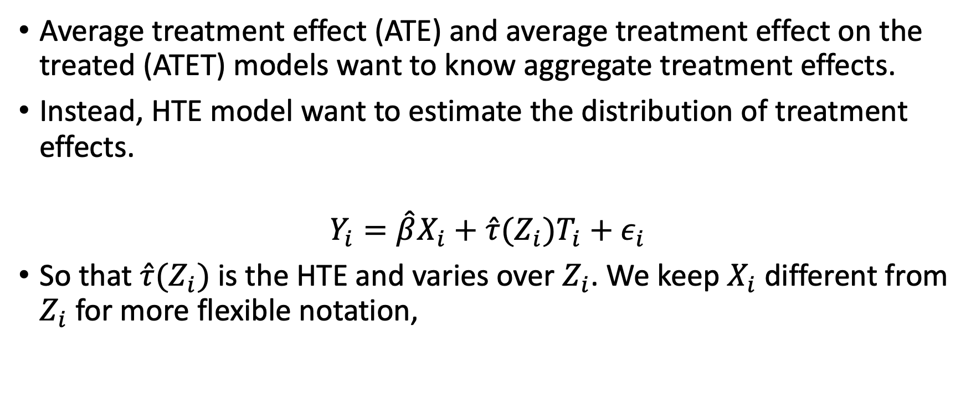
HTE Overview
Average treatment effect (ATE) and average treatment effect on the treated (ATET) models want to know aggregate treatment effects.
Instead, HTE model want to estimate the distribution of treatment effects.
$$Y_{i}=\hat{β}X_{i}+\hat{τ}(Z_{i})T_{i}+ε_{i}$$
So that $\hat{τ}(Z_{i})$is the HTE and varies over $Z_{i}$. We keep $X_{i}$ different from $Z_{i}$ for more flexible notation,

Slide 5
How much variation do we want in HTE?
Two extremes:
1. Individualized treatment estimates allow more flexibility, but can demand large sample sizes and variation in data.
Increases the risk of noise driving estimates
2. Segmented estimates are the least inflexible, with the least risk of noise driving estimates.
In-between case is to allow treatment effects to vary across some dimensions, but not others.

Slide 6
HTE ideal experiment
We can understand these two extreme based on what the ideal experiment is to estimate unbiased HTE.
For individualized HTE, the ideal is to randomize treatment for each individual. (impossible)
For segmented HTE, the ideal is to randomize treatment for each segment. (stratified randomization)
The more individualized HTE is, the more data and assumptions are needed to distinguish between real patterns and statistical noise in the data.

Slide 7
HTE inference challenge
Statistical inference for ATE/ATET estimates is based on the distribution of error around the average estimate.
The challenge is getting a distribution around an individual estimate.
The solution is to rely on either model specifications or bootstrapping-esque methods.

Slide 8
Some HTE Models

Slide 9
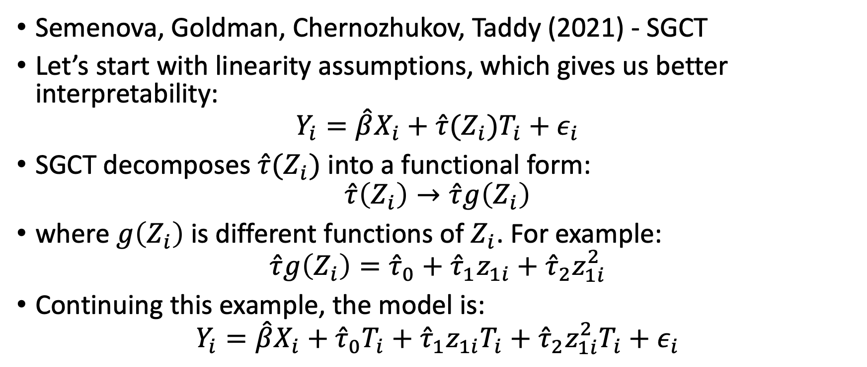
DML-Style Models
Semenova, Goldman, Chernozhukov, Taddy (2021) - SGCT
Let’s start with linearity assumptions, which gives us better interpretability:
$$Y_{i}=\hat{β}X_{i}+\hat{τ}(Z_{i})T_{i}+ε_{i}$$
SGCT decomposes $\hat{τ}(Z_{i})$ into a functional form:
$$\hat{τ}\left(Z_{i}\right)→\hat{τ}g\left(Z_{i}\right)$$
where $g\left(Z_{i}\right)$ is different functions of $Z_{i}$. For example:
$$\hat{τ}g\left(Z_{i}\right)={\hat{τ}}_{0}+{\hat{τ}}_{1}z_{1i}+{\hat{τ}}_{2}z_{1i}^{2}$$
Continuing this example, the model is:
$$Y_{i}=\hat{β}X_{i}+{\hat{τ}}_{0}T_{i}+{\hat{τ}}_{1}z_{1i}T_{i}+{\hat{τ}}_{2}z_{1i}^{2}T_{i}+ε_{i}$$

Slide 10
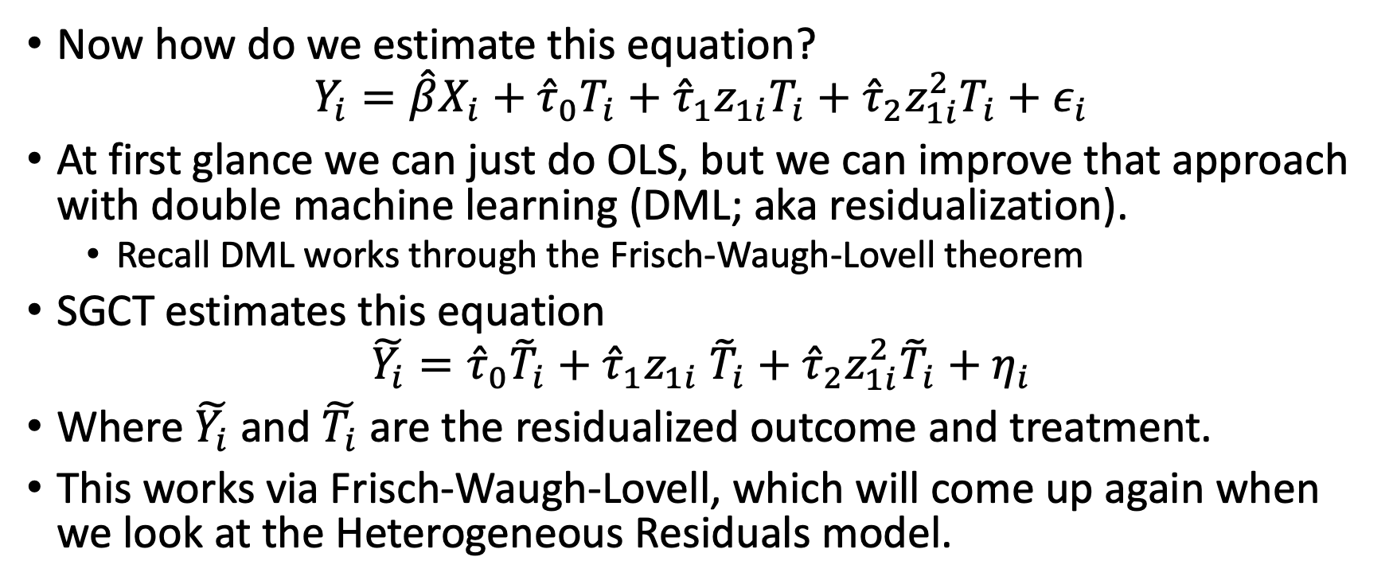
SGCT uses residualization
Now how do we estimate this equation?
$$Y_{i}=\hat{β}X_{i}+{\hat{τ}}_{0}T_{i}+{\hat{τ}}_{1}z_{1i}T_{i}+{\hat{τ}}_{2}z_{1i}^{2}T_{i}+ε_{i}$$
At first glance we can just do OLS, but we can improve that approach with double machine learning (DML; aka residualization).
Recall DML works through the Frisch-Waugh-Lovell theorem
SGCT estimates this equation
$$\tilde{Y_{i}}={\hat{τ}}_{0}{\tilde{T}}_{i}+{\hat{τ}}_{1}z_{1i} {\tilde{T}}_{i}+{\hat{τ}}_{2}z_{1i}^{2}{\tilde{T}}_{i}+η_{i}$$
Where $\tilde{Y_{i}}$ and $\tilde{T_{i}}$ are the residualized outcome and treatment.
This works via Frisch-Waugh-Lovell, which will come up again when we look at the Heterogeneous Residuals model.

Slide 11
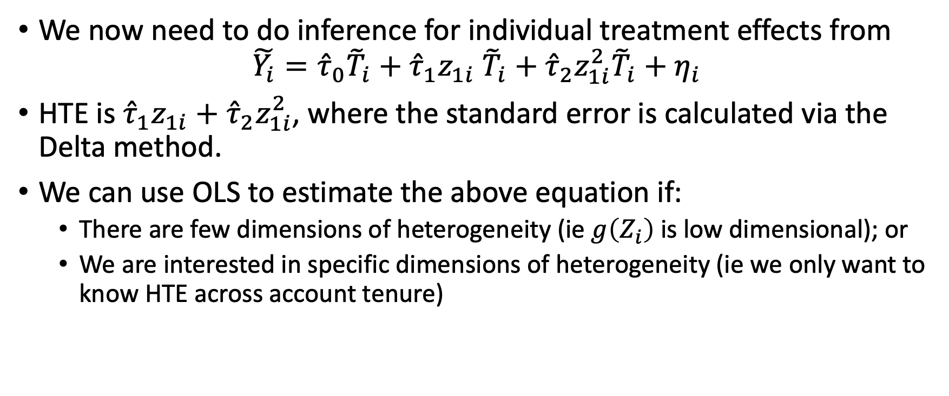
SGCT – HTE and inference
We now need to do inference for individual treatment effects from
$$\tilde{Y_{i}}={\hat{τ}}_{0}{\tilde{T}}_{i}+{\hat{τ}}_{1}z_{1i} {\tilde{T}}_{i}+{\hat{τ}}_{2}z_{1i}^{2}{\tilde{T}}_{i}+η_{i}$$
HTE is ${\hat{τ}}_{1}z_{1i}+{\hat{τ}}_{2}z_{1i}^{2}$, where the standard error is calculated via the Delta method.
We can use OLS to estimate the above equation if:
There are few dimensions of heterogeneity (ie $g\left(Z_{i}\right)$is low dimensional); or
We are interested in specific dimensions of heterogeneity (ie we only want to know HTE across account tenure)

Slide 12
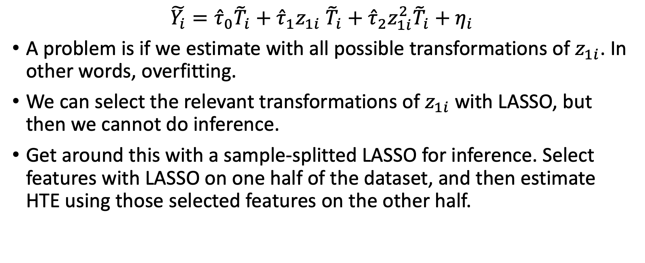
SGCT – inference with post-LASSO regression
$$\tilde{Y_{i}}={{\hat{τ}}_{0}{\tilde{T}}_{i}+\hat{τ}}_{1}z_{1i} {\tilde{T}}_{i}+{\hat{τ}}_{2}z_{1i}^{2}{\tilde{T}}_{i}+η_{i}$$
A problem is if we estimate with all possible transformations of $z_{1i}$. In other words, overfitting.
We can select the relevant transformations of $z_{1i}$ with LASSO, but then we cannot do inference.
Get around this with a sample-splitted LASSO for inference. Select features with LASSO on one half of the dataset, and then estimate HTE using those selected features on the other half.

Slide 13
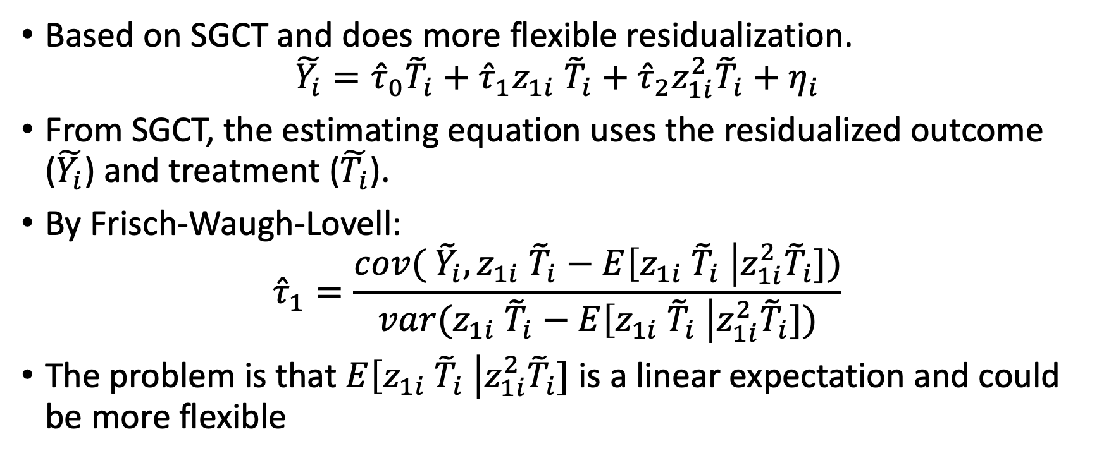
Heterogeneous residuals (HR)
Based on SGCT and does more flexible residualization.
$$\tilde{Y_{i}}={{\hat{τ}}_{0}{\tilde{T}}_{i}+\hat{τ}}_{1}z_{1i} {\tilde{T}}_{i}+{\hat{τ}}_{2}z_{1i}^{2}{\tilde{T}}_{i}+η_{i}$$
From SGCT, the estimating equation uses the residualized outcome ($\tilde{Y_{i}}$) and treatment ($\tilde{T_{i}}$).
By Frisch-Waugh-Lovell:
$${\hat{τ}}_{1}=\frac{cov( {\tilde{Y}}_{i},z_{1i} {\tilde{T}}_{i}−E\left[z_{1i} {\tilde{T}}_{i} \right|z_{1i}^{2}{\tilde{T}}_{i}])}{var(z_{1i} {\tilde{T}}_{i}−E\left[z_{1i} {\tilde{T}}_{i} \right|z_{1i}^{2}{\tilde{T}}_{i}])}$$
The problem is that $E\left[z_{1i} {\tilde{T}}_{i} \right|z_{1i}^{2}{\tilde{T}}_{i}]$ is a linear expectation and could be more flexible
Notes:
There is a minor point here about how reasonable it is to condition on the squared version of a variable. However, we can make the same argument if instead of $z_{1i}$, we had $z_{2i}$. Note the argument ${\tilde{T}}_{i}$ contains information about the other covariates does not hold because by construction it has to be uncorrelated with other features.
The linear expectation is done because OLS implicitly does a linear expectation for residualization. You can see this yourself if you were to use OLS (without any cross-fitting) in a simple DML model.

Slide 14
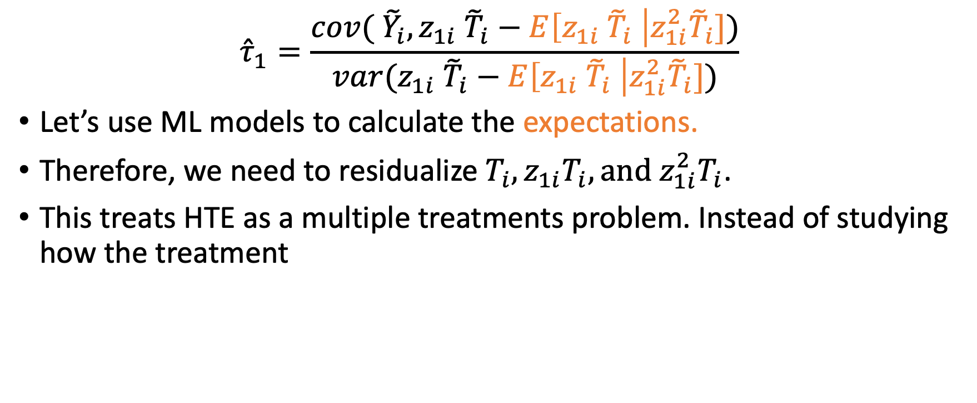
HR – flexible residualization
$${\hat{τ}}_{1}=\frac{cov( {\tilde{Y}}_{i},z_{1i} {\tilde{T}}_{i}−E\left[z_{1i} {\tilde{T}}_{i} \right|z_{1i}^{2}{\tilde{T}}_{i}])}{var(z_{1i} {\tilde{T}}_{i}−E\left[z_{1i} {\tilde{T}}_{i} \right|z_{1i}^{2}{\tilde{T}}_{i}])}$$
Let’s use ML models to calculate the expectations.
Therefore, we need to residualize $T_{i}, z_{1i}T_{i},{\text{and} z_{1i}^{2}T}_{i}$.
This treats HTE as a multiple treatments problem. Instead of studying how the treatment

